Slide 1
Unit 6: Three-Dimensional Object Representation and Curve Modeling (6 Hrs.)
Boundary Surface Representation Vs Space Partitioning Representation
Polygon Surface Representation: Polygon Table and Polygon Meshes, Wireframe and Sweep Representation, Octree Representation, Bezier Curve, B-Spline Curve,
Fractal-Geometry: Fractal Dimension, Koch Curve

Slide 2
B-Spline Curve in Computer Graphics
Concept of B-spline curve came to resolve the disadvantages having by Bezier curve, as we all know that both curves are parametric in nature.
In Bezier curve we face a problem, when we change any of the control point respective location the whole curve shape gets change. But here in B-spline curve, the only a specific segment of the curve-shape gets changes or affected by the changing of the corresponding location of the control points.
In the B-spline curve, the control points impart local control over the curve-shape rather than the global control like Bezier-curve.

Slide 3
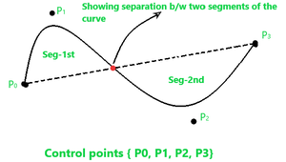
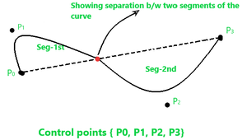
B-spline curve shape before changing the position of control point P1 –
B-spline curve shape after changing the position of control point P₁
You can see in the above figure that only the segment-1st shape as we have only changed the control point P1, and the shape of segment-2nd remains intact.

Slide 4
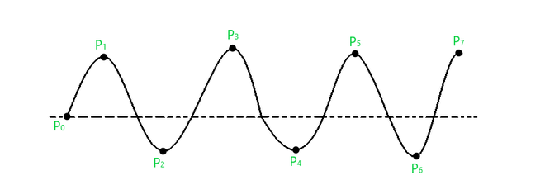
B-spline Curve :
As we see above that the B-splines curves are independent of the number of control points and made up of joining the several segments smoothly, where each segment shape is decided by some specific control points that come in that region of segment. Consider a curve given below –
Attributes of this curve are –
We have “n+1” control points in the above, so, n+1=8, so n=7.
Let’s assume that the order of this curve is ‘k’, so the curve that we get will be of a polynomial degree of “k-1”. Conventionally it’s said that the value of ‘k’ must be in the range: 2 ≤ k ≤ n+1. So, let us assume k=4, so the curve degree will be k-1 = 3.
The total number of segments for this curve will be calculated through the following formula –
Total no. of seg = n – k + 2 = 7 – 4 + 2 = 5.

Slide 5
Knots in B-spline Curve :
The point between two segments of a curve that joins each other such points are known as knots in B-spline curve. In the case of the cubic polynomial degree curve, the knots are “n+4”. But in other common cases, we have “n+k+1” knots. So, for the above curve, the total knots vectors will be –
Total knots = n+k+1 = 7 + 4 + 1 = 12
These knot vectors could be of three types –
Uniform (periodic)
Open-Uniform
Non-Uniform
Segments Control points Parameter
S0 P0,P1,P2,P3 0≤t≤2
S1 P1,P2,P3,P4 2≤t≤3
S2 P2,P3,P4,P5 3≤t≤4
S3 P3,P4,P5,P6 4≤t≤5
S4 P4,P5,P6,P7 5≤t≤6

Slide 6
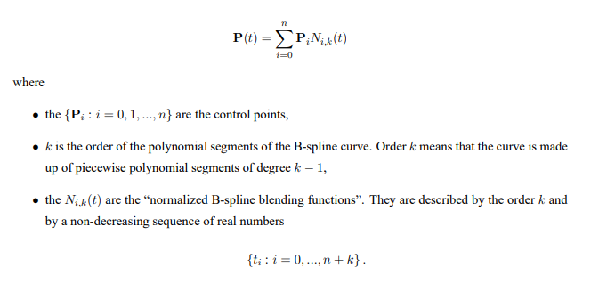

B-spline Curve Equation : The equation of the spline-curve is as follows –
$$=\sum_{k=0}^{n}{\left({n \atop }\right)x^{k}a^{n−k}}$$
P(t) = Xn i=0 PiNi,k(t)

Slide 7
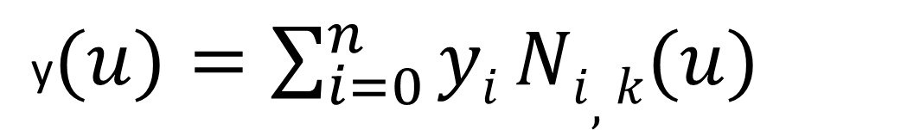
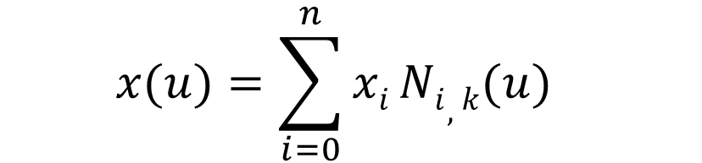
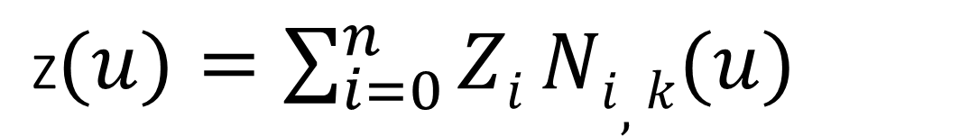
$$x(u)=\sum_{i=0}^{n}{xi}{Ni,k(u)}^{}$$
y$(u)=\sum_{i=0}^{n}{yi}{Ni,k(u)}^{}$
Z$(u)=\sum_{i=0}^{n}{Zi}{Ni,k(u)}^{}$

Slide 8
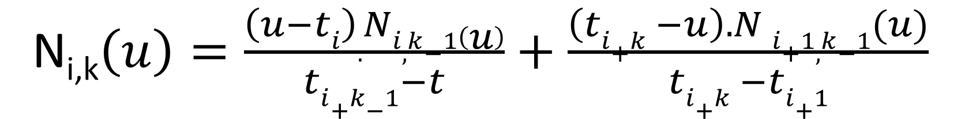
N_{i,k}$\left(u\right)=\frac{\left(u−ti\right).Ni,k−1\left(u\right)}{ti+k−1−t}+\frac{\left(ti+k −u\right).N i+1,k−1(u)}{ti+k −ti+1}$
Where
t_{i}= Joint point of which pieces of curve joint (knot value)
i = 0<=i<=n+k
To find value of t_{i} we need the following formula
t_{i} = 0 if i<k
t_{i} = i-k+1 if k<= i<=n
t_{i} = n-k+2 if i<n

Slide 9
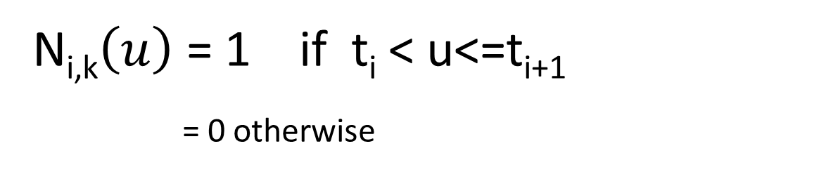
N_{i,k}$\left(u\right)$ = 1 if t_{i} < u<=t_{i+1}
_{= 0 otherwise}

Slide 10
Control point 6 and value k =3 find the all possible knot value with segment by using b-Spline curve
Given CP =6
n = 6-1 = 5
Possible combination of segement [p0………………..p5)
P_{0.}N_{0,3}(u) + p₁N_{1,3}(u) +………………….+p₅N_{5,3}(u)
Where
u = n-k+2 = 5-3+2 = 4 total number of segment made
S₀ = p₀p₁p₂
S₁ = p₁p₂p₃
_{S2} = continue

Slide 11
T₀ -=0 | =i= 0 | K =3
t1 =0 | 1 | K =3
t2 = 0 | 2 | K =3
t3 =1 | 3 | K =3
t4 = 2 | 4 | K =3
t5 =3 | 5 | K =3
t6 =4 | 6 | K =3
t7 =4 | 7 | K =3
Cp =7
K=3
To find value of t_{i} we need the following formula
t_{i} = 0 if i<k
t_{i} = i-k+1 if k<= i<=n
t_{i} = n-k+2 if i>n

Slide 13
Properties of B-spline Curve :
Each basis function has 0 or +ve value for all parameters.
Each basis function has one maximum value except for k=1.
The degree of B-spline curve polynomial does not depend on the number of control points which makes it more reliable to use than Bezier curve.
B-spline curve provides the local control through control points over each segment of the curve.
The sum of basis functions for a given parameter is one.

Slide 14
Spline | B-Spline | Bezier
A spline curve can be specified by giving a specified set of coordinate positions, called control points which indicate the general shape of the curve. | The B-Spline curves are specified by Bernstein basis function that has limited flexibiity. | The Bezier curves can be specified with boundary conditions, with a characterizing matrix or with blending function.
It follows the general shape of the curve. | These curves are a result of the use of open uniform basis function. | The curve generally follows the shape of a defining polygon.
Typical CAD application for spline include the design of automobile bodies, aircraft and spacecraft surfaces and ship hulls. | These curves can be used to construct blending curves. | These are found in painting and drawing packages as well as in CAD applications.
It possess a high degree of smoothness at the places where the polynomial pieces connect. | The B-Spline allows the order of the basis function and hence the degree of the resulting curve is independent of number of vertices. | The degree of the polynomial defining the curve segment is one less than the number of defining polygon point.
A spline curve is a mathematical representation for which it is easy to build an interface that will allow a user to design and control the shape of complex curves and surfaces. | In B-Spline, there is local control over the curve surface and the shape of the curve is affected by every vertex. | It is a parametric curve used in related fields.

